Slide 1
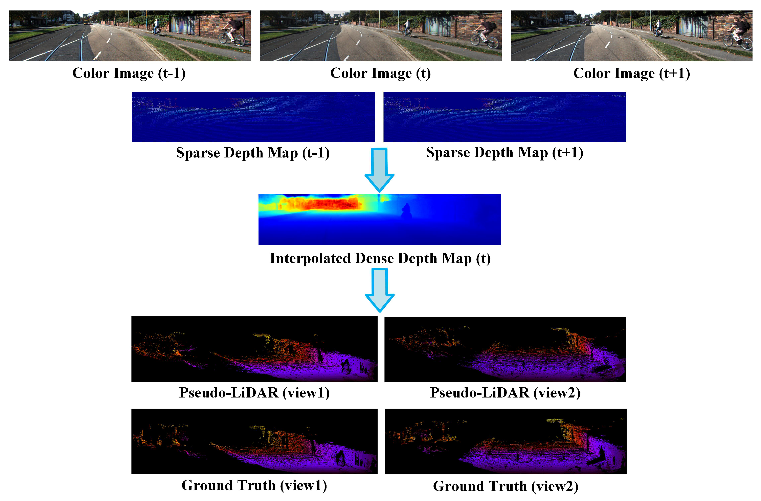
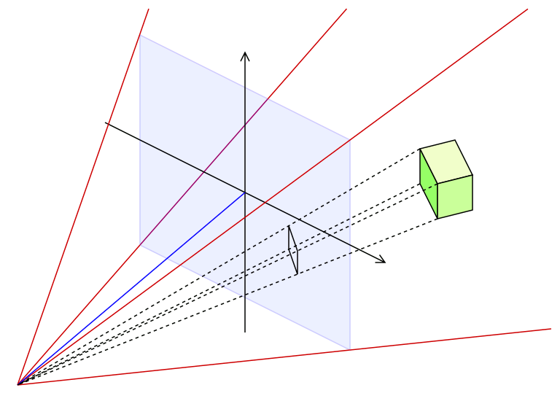
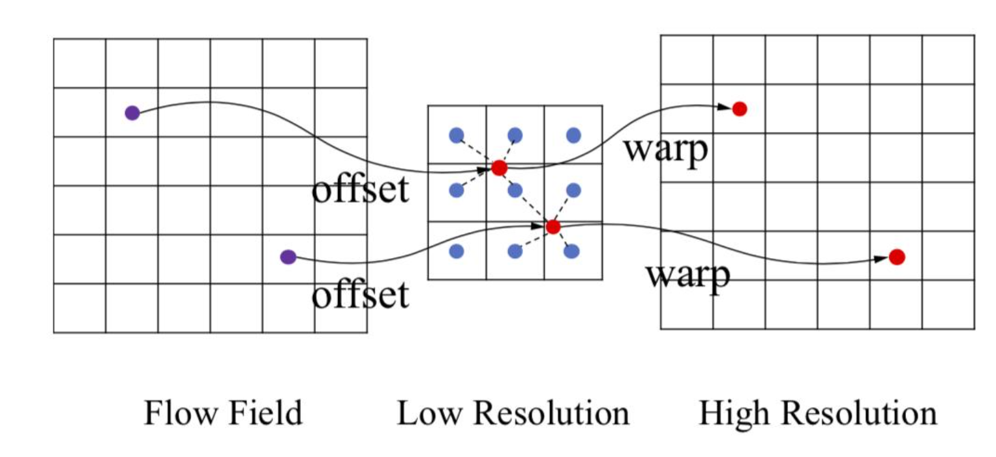
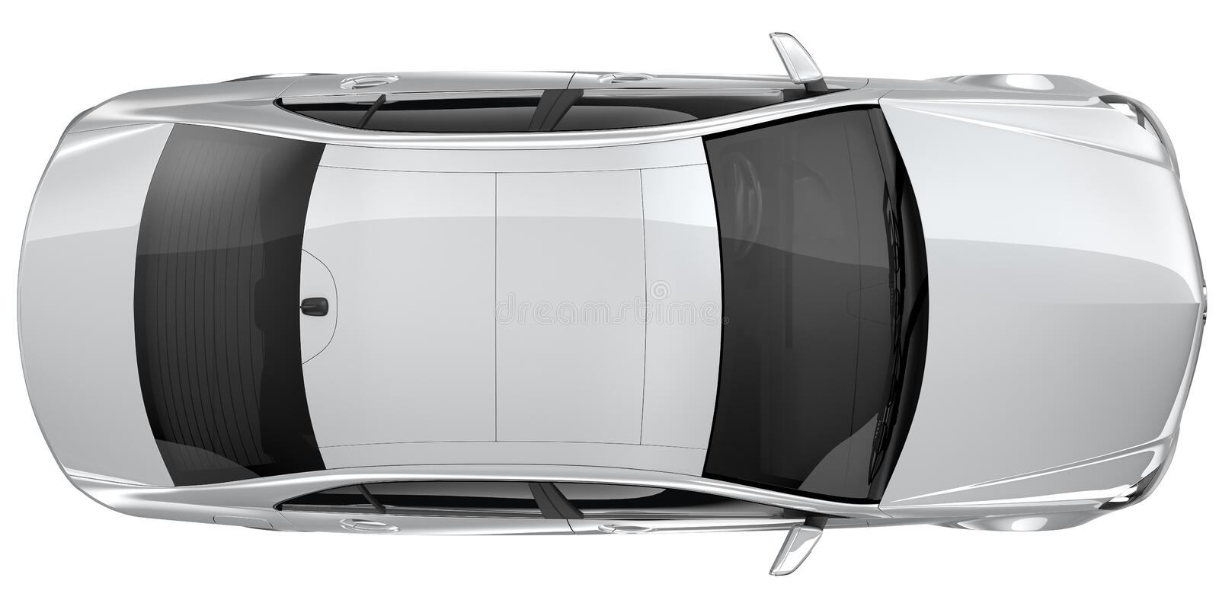

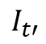
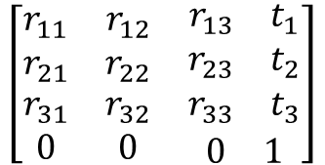

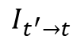
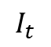
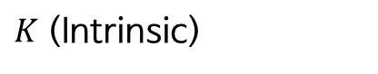
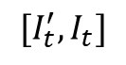
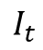
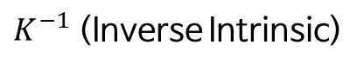

3D Point ( t’ Frame)
3D Point ( t Frame)
$K$ (Intrinsic)
$K^{−1}$ (Inverse Intrinsic)
$$\left[\begin{matrix}r_{11} & r_{12} & \begin{matrix}r_{13} & t_{1}\end{matrix} \\ r_{21} & r_{22} & \begin{matrix}r_{23} & t_{2}\end{matrix} \\ \begin{matrix}r_{31} \\ 0\end{matrix} & \begin{matrix}r_{32} \\ 0\end{matrix} & \begin{matrix}\begin{matrix}r_{33} & t_{3}\end{matrix} \\ \begin{matrix}0 & 1\end{matrix}\end{matrix}\end{matrix}\right]$$
Depth Map (from Disparity)
Transformation matrix
(from Rotation, Translation vector)
$2$D Projection
$uv$ 좌표 리스트
Pose Network
Depth Network
Grid Sampling (from $I_{t′}$)
$$[I_{t}^{′}, I_{t}]$$
$$I_{t}$$
이
동
방
향
$$I_{t}$$
$$I_{t^{′}→t}$$
Photometric
Reprojection Error
$$I_{t′}$$
t’ Frame 시점
t’ Frame 시점 (t-1)

